Slide 1
Software Engineering and Architecture
Broker II Mandatory
Distributed HotStone

Slide 2
Broker II
Learning Goal
  Get the handle object reference methods implemented
    c = getCardInHand(w,i), attackCard(w,a,d), and cousins...
    Involves objectId generation and usage
  Get the MiniDraw GUI integrated in a full client
  Get the Invoker code segregated
    Refactor ‘blob invoker’ to a subinvoker/multitype dispatch approach
Product Goal
  JUnit test suite that cover all broker related code
  System testing of a full HotStone GUI based remote play! Wow!

Slide 3
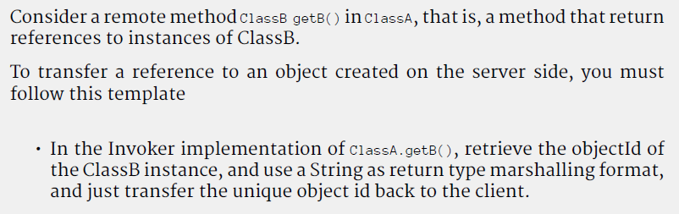

Broker 2.1
TDD the Game methods that handles object references.
That is, write JUnit tests that implement the FRDS method

Slide 4
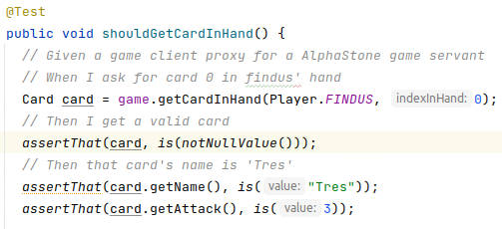
Small Steps
Keep doing it ‘depth-first’
  But the first ‘deep dive’ have some issues
I recommend to introduce AlphaStone as your servant
  To avoid writing too much stub code ☹
Example:
  On my test list: “make getCardInHand(Findus, 0) work”

Slide 5
Small Steps
Take small steps – again a proxy step + an invoker step
  (1) Involves making the GameClientProxy method
    Request String/objectId from the server
    Wrap that objectId in a CardClientProxy
  (2) Involves making the Invoker handling
      If OpName.equals(GAME_GET_CARD_IN_HAND)
        Ask game for the card - servant upcall
        Return the card’s objectId as serialized JSON

Slide 6


Small Steps - FakeIt
… But the test case likely fails (it did for me) – why?
Because we still have FakeIt lookup code for the card!
Now test drive the invoker side’s
  Insert (card id, card) mapping in a name service
  Refactor the fake ‘lookupCard()’ method into a proper impl.
One method done; repeat until all covered ☺

Slide 7
ID Generation
There are several ways to generate ID’s
  Invoker can do it
  Domain object can do it
IDs are rather pervasive (Read: all objects need it, even the client proxy) in a distributed setting so my recommendation is a role interface on the domain obj:
  RoleInterface: interface Identifiable { String getId(); }
  Let Card and Hero extend that interface
  Let constructor create a random id ala

Slide 8

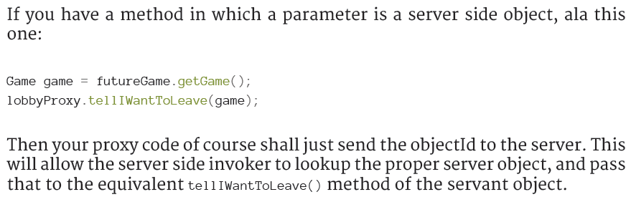
Pass-By-Ref Parameters
Game have many methods whose parameters are object references
But – they are server created objects, so no problem

Slide 9




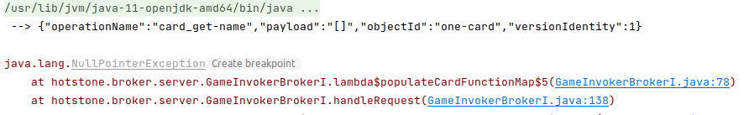
Removing FakeIt / Scaffolding
Once you start removing the scaffolding/fake it code
… other tests may fail…
  Huh – what is going on?
Notes:
In my case: because I created the card = new CardClientProxy(…); but I cannot directly create proxies in the client any longer; I have to fetch them from the server, så detour around the server: card = gameProxy.getCardInHand(…);

Slide 10

Removing Scaffolding
My original test case created CardClientProxy directly
Now, we cannot do that as
  Clients do not create cards – servers do!
So the answer is of course…
  Servers create cards, so our test case must follow that rule
Ups – and test cases/doubles refactored…
  Probably other return values, so asserts must be updated…
Notes:
In my case, the test cases for CardBroker implementation relied on a Stub card; but now I retrieve a card from the gameServant. If these two are not the same, then of course the test cases fail. Either use a game servant with stub cards that are identical to the ones in the test case – OR change the assert values in the test cases so they match the transferred card.

Slide 11
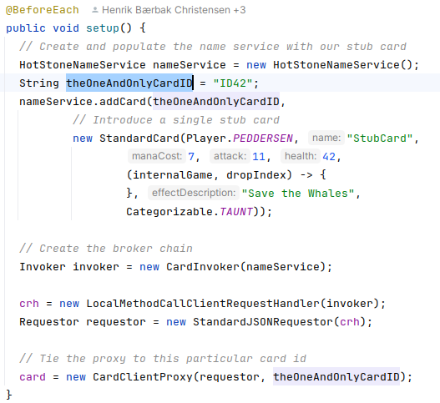
Removing Scaffolding
Alternatively, you can also insert your ‘test stub’ card directly into the Invoker’s name service…
Note: I have solved the ‘dispatching’ exercise…

Slide 12
Iterables
And what about Iterable<>?
The return type is ‘something that can iterate Cards’
  List<Card> is an Iterable<? extends Card>
  And what is Card in our context?
Solution:
  List of ObjectId’s of the associated cards from server
  Client must then convert that into a List<CardClientProxy>

Slide 13
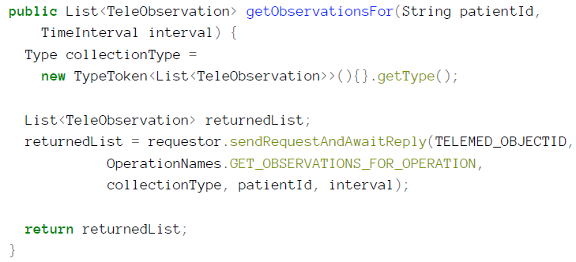
List<Something>
Gson can easily marshall and demarshall Lists but you need a bit of ‘magic’ to define that type. List<String>.class is not valid Java.
  Actually shown an example of it in TeleMed code

Slide 14
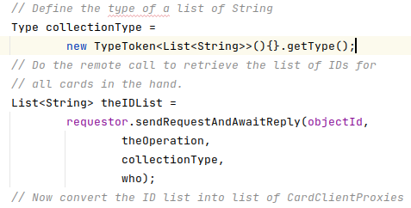
List<String>
So this is the way to go
Fill in the details…

Slide 15
2.2 System Testing
A full distributed playable system…

Slide 16
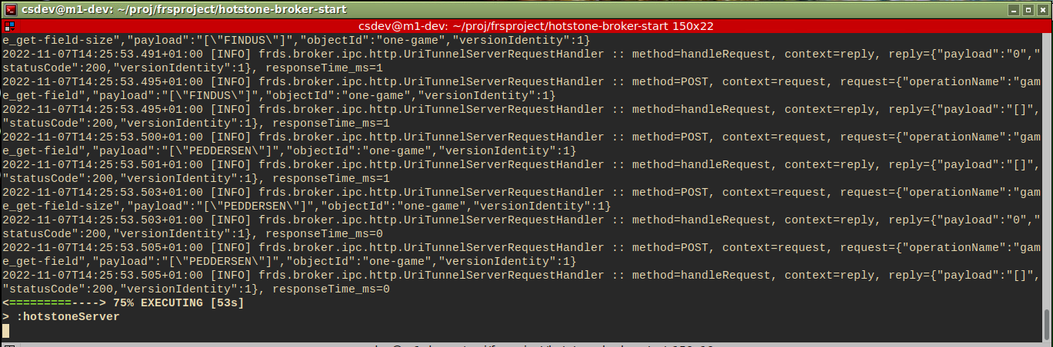
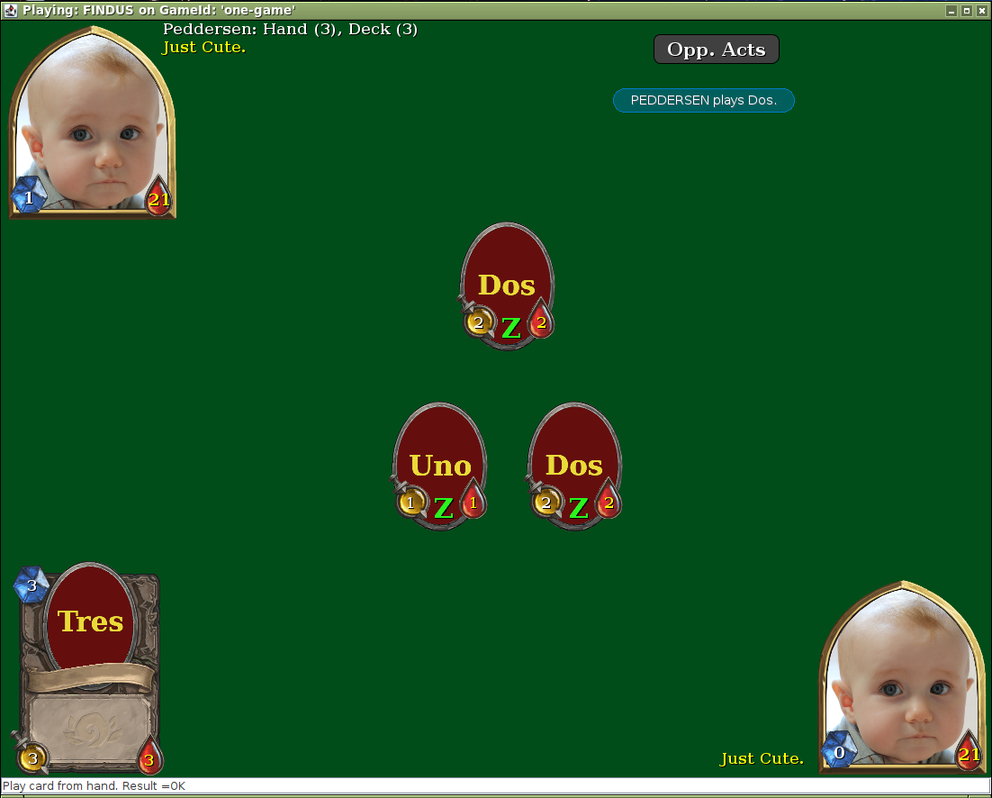
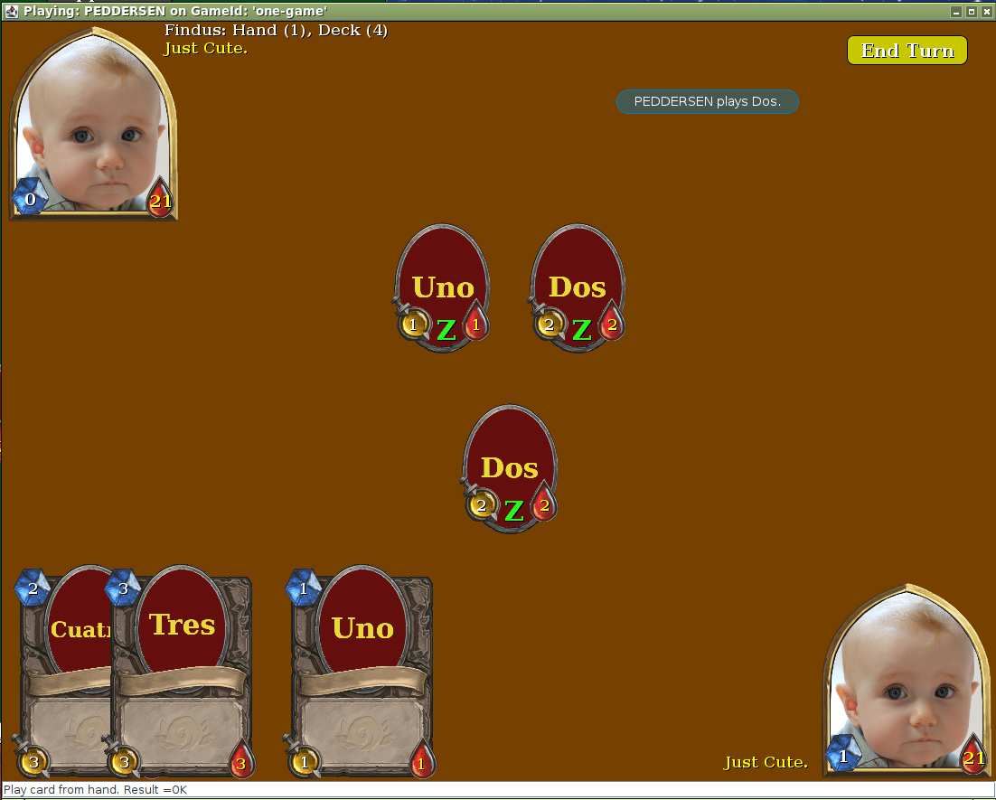
Product Goal: Full system
A server and
  Two clients
Notes:
META: Own code base in ‘frsproject/hotstone-broker-start’ branch ‘e22-broker-solution’

Slide 17


Limitation: No Observer
FRDS Broker does not support server-to-client calls
  Thus GameServant cannot invoke GameObserver’s on the client side
Solution provided: The refresh button
That is:
  The player which is not active player / not in turn
  … have to press the ‘next opponent action’ button every 2-5-10 seconds…

Slide 18
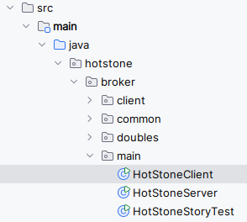
Guide to Tackling Integration
System testing = manual testing
  But remember the small steps
What do need?
  A Game server Done! Made in Broker I mandatory ☺
  A Game Client Starting point provided…

Slide 19
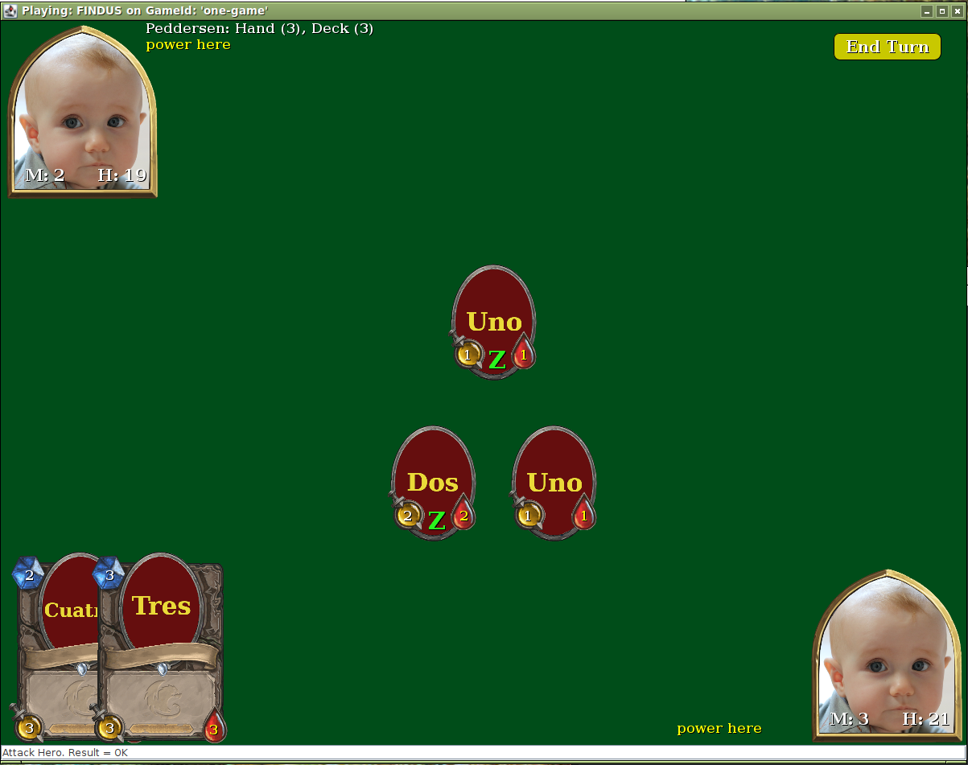
Small Step 1
I often call this ‘First Light’
  The first time I see “something working”
  (In Astronomy ‘first light’ is the first time you see the night sky through a new telescope ☺)
HotStoneClient’s main() method
  Setup broker chain to server
  Initialize Iteration 8’s GUI code with our game proxy
  See a UI pop up ☺
    Or hit a zillion null ptr exception ☹

Slide 20
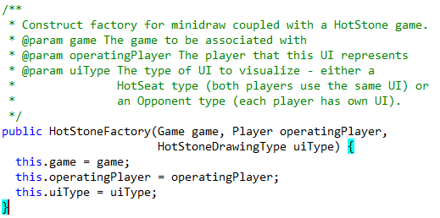
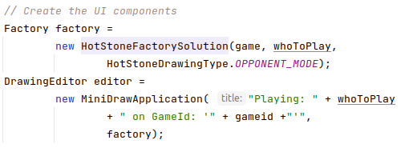
Hints: HotStoneClient
The Factory is prepared for Remote Play
  The
  ‘OPPONENT_MODE’

Slide 21

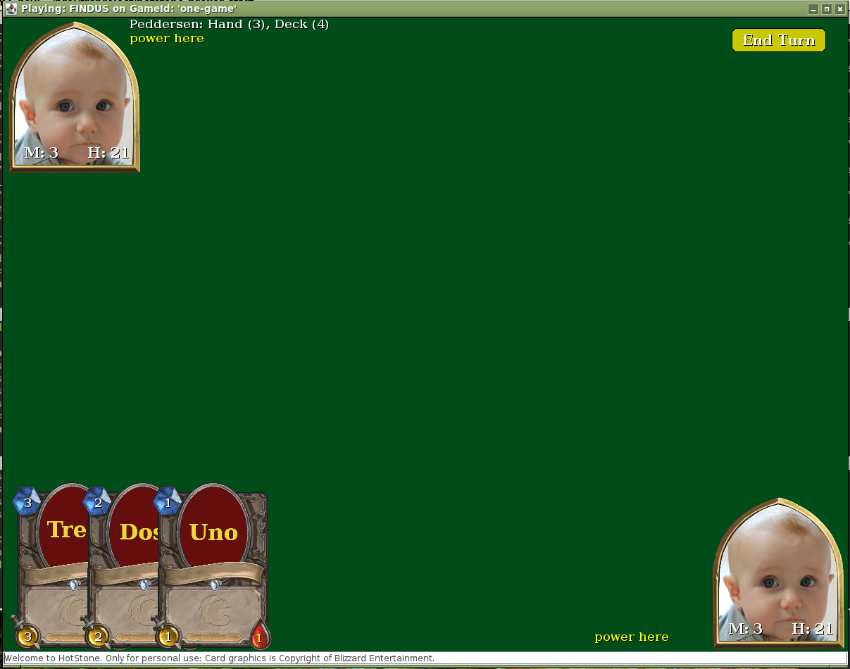
First Light
Just use a Null tool –
  But – We cannot do anything???
Yes, but small steps!!!
  Verify that the UI pop up correctly
I see the correct UI
I see correct server communication
I cannot do anything
  But that is “next small step”, right?!

Slide 22


NullPointer Issue
Most of you probably create CardClientProxies like crazy
  Every ‘getCardInHand()’ creates a new CardClientProxy
But HotStoneDrawing keeps a mapping (card, actor):
  Given a card, it can fetch the associated Figure
Exercise
  Why will this no longer work???
  What is the solution to make the Drawing work again???
  And will this solution be backwards compatible? Work in ‘HotSeat’ mode?
Notes:
Because the ‘card’ is a card proxy which is garbage collected and replaced by a new one!
Solution: HotStoneDrawing needs something the uniquely ties a card on the server with a graphical Figure. And that is the cards objectId = card.getId(). So reprogram the actorMap to be a Map<String, HotStoneFigure> mapping instead; where the key is the objectId of the card, not the card reference.
And yes it is backwards compatible – because every card (even in hotseat mode) will create a unique ID!

Slide 23
We are actually almost done!
What Tool to use?
  Of course not our ‘HotSeatStateTool’
    It operates both Findus and Peddersen
We need a new state tool which is almost identical but not quite
That is, a tool which determine what tool to delegate to, based upon the figure underneath…
But first – we have to discuss GUI updates…

Slide 24
Domain -> GUI Updates
The missing Observer pattern ☹

Slide 25

GUI Updates: Analysis
How did it work in the HotSeat variant?
  Example: User clicks the Hero figure which is Thai Chef:
    Call game.usePower(…)
    Game calls proper observer methods
    HotStoneDrawing implements these, and redraws Gfx
      In the ‘onHeroUpdate()’ methods
Our issue here: Server cannot call ‘onHeroUpdate()’
localhost
GameClientProxy
91.112.34.12
GameServant
Impossible

Slide 26
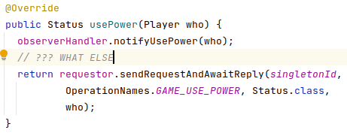
Missing Observer
Where does that lead us?
  FRDS.Broker is a lousy framework! ☺
    No, but it respects the client-server paradigm, as REST does…
    It is not allowed, because it is an architecturally bad idea…
  Build observer handling into the GameClientProxy?
    Hm…
    Exercise: What is difficult
    here???
Notes:
The issue is, that we actually do not know what actions were taken server side – our client side calls are second guessing what happened on the server! For instance for Danish Chef, it is a onPlayCard() event instead of a onHeroUpdate(opponent) ☹

Slide 27
Missing Observer
HotStone is a really tricky game, as the open-ended world of ‘card effects’ and ‘hero powers’ allows new variants to be made but only the server knows what happened!
  The idea, nevertheless, may make sense in other games
What ever we do client side, it will always be a qualified guess
  And we will guess wrong!!!
    Inconsistent GUI Findus sees one thing, Peddersen another
Proposal rejected!

Slide 28
Second Proposal
The path you will take in the Broker II is a performance wise catastrophe – but it works!
  SWEA is foremost a learning experience, not product development…
The Brute Force Redraw Approach
  ☹ because it is very expensive performance wise…
  (and energy-wise ☹☹)
Proposal: As we do not know what happened, we simply redraw everything upon every mutation call…

Slide 29
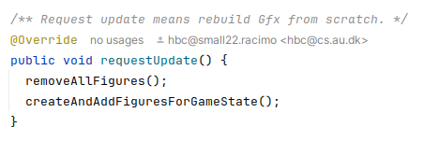
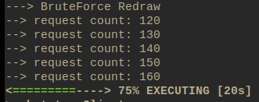
Brute Force Redraw
Fortunately MiniDraw has the method required
In the delivered HotStoneDrawing implementation
Downside
  About 40-50 remote calls ☹

Slide 30
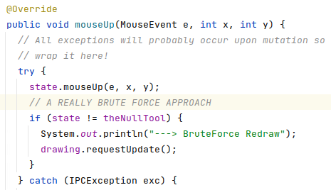
When?
When do I need a brute force redraw?
  Upon every mutator call…
Who makes the mutator calls?
  The tools
Who delegates to the tools?
  The State tool ☺
  One small optimization
    No redraw for null tool ☺

Slide 31

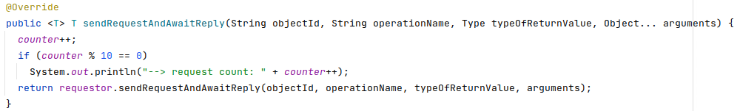
(Counting Decorator)
To get an idea of amount of client requestor calls

Slide 32
… Back to the Tool

Slide 33
We are actually almost done!
We need a new state tool which is almost identical but not quite
  Which, qua the previous analysis, does brute force redrawing after each mutation call…
In addition, there is one new button to cope with:
  The ‘refresh’ button
    You tool must handle clicking this…

Slide 34
OpponentButtonTool
What should an OpponentButtonTool do?
  Well – redraw the GUI, right ☺
One missing thing
  The Blue Message boxes are gone ☹
  Leave it at that is quite ok…
    Same argument – we do not know what to write in them
  [How come Henrik’s remote game does include them???]

Slide 35
A Third/Forth Path
The performance penalty is problematic
  Testing on localhost is probably OK
  Having a server in Amsterdam is not OK
I will discuss another path taken in the HotStone game server…
  … in my energy-efficiency talk
    Zillions of network calls wastes quite a lot of energy!

Slide 36
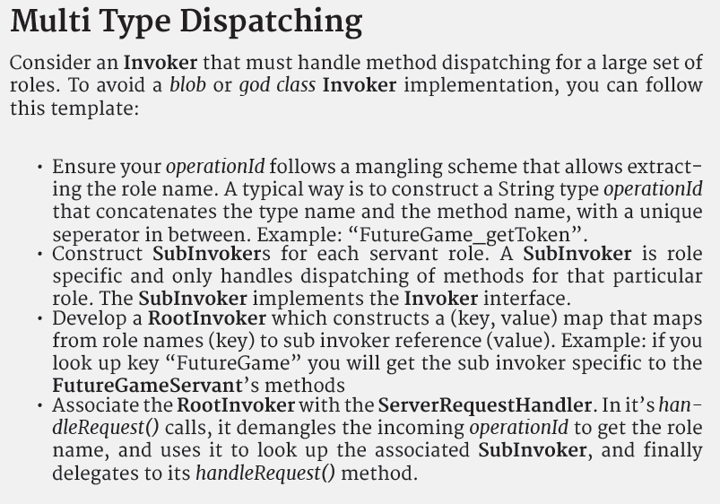
Broker 2.3
Split the ‘blob invoker’ from 2.2 into subinvokers, following the principles in multi type dispatch.
Ala
  RootInvoker
    Delegating to
      GameInvoker
      CardInvoker
      HeroInvoker
FRDS §5.4 issue 2

Slide 37
Broker 2.3
This exercise does give points in your score, but…
It is valid to skip it entirely
  Permanently on the backlog
At the Exam, I have yet to see a student who solves the exam exercise so fast, that we get to discuss multitype dispatch

Slide 38
Side Note
Optional Material!
Do not implement this ☺
How I have solved the
‘missing Observer’ issue.
In a Compositional Way

Slide 39
Idea
The observer events are there!
  They happen on the server side
We just can’t get them over the network
  Broker does not allow server to call an Observer on client
  Only Pass-by-Value
One Solution:
  Record observer events as ‘pass-by-value’ objects on server
  Transfer this List<ObserverEvent> to client
  Replay this list of events on the client side

Slide 40
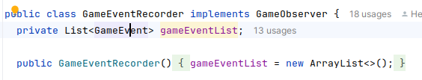
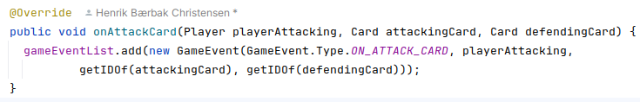
GameEvent Recorder
How to Record all observer events?

Slide 41
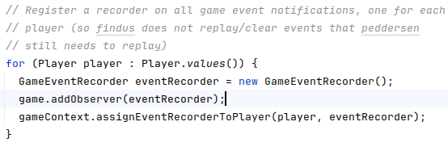
Add that observer to Game
Actually need one recorder for each player!
  Why?
Notes:
Because we need to clear the list once the client has replayed it to avoid replaying twice; but Findus must not clear Peddersens event list!

Slide 42
Client Side
The GameClientProxy’s call of any mutator must now
  Ask server for that list of events (and clear it server side)
  Replay the events
This is not the responsibility of a ClientProxy!
We know the pattern to solve this, right?

Slide 43


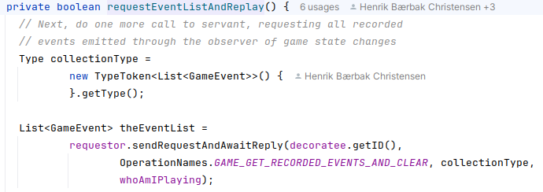

Decorator
Decorator: Add behavior to existing class
Notes:
The GameEventPlayer simply reads each game event and fires the exact same event as the recorded one

Slide 44

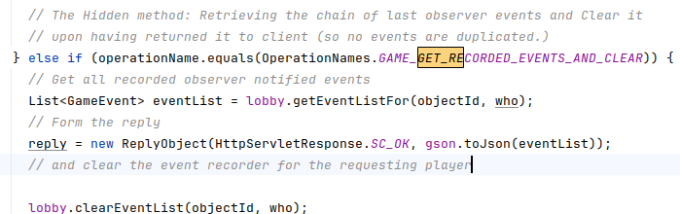
Hidden Method
Relies on a Hidden Method in the Invoker

Slide 45
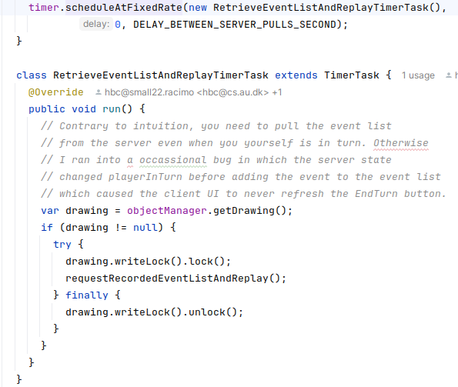
Latest Addition
Add ‘auto fetch every 2,5 seconds and reply’
Not the responsibility of the ReplayDecorator
We know the pattern to solve that ☺

Slide 46
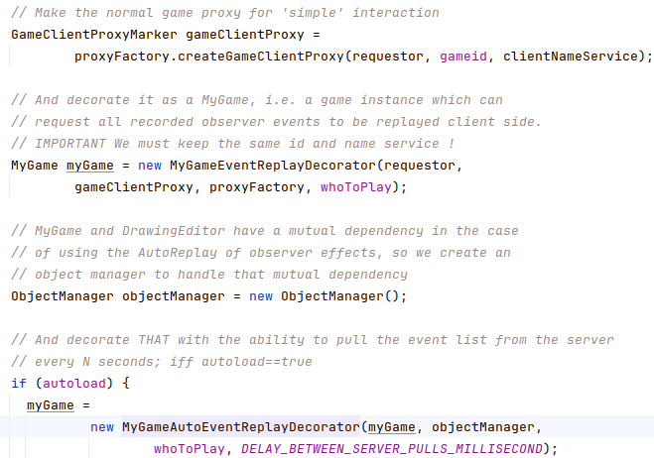
So a double decorated Game
Creating the resulting ‘Game’ is a three step process

Slide 47

Compositional Design
Morale:
  I needed to add a lot of complex additional behavior
  But I used compositional design to change by addition!
Only adding new classes, not changing any!
  Event recording by adding an observer server side
    And separate classes to record events and replay them
  Fetching event list from server by adding decorators on the GameClientProxy
All additions are under automated test control!

Slide 48
HotStone Server Loads
Modern CPUs are bored…

Slide 49
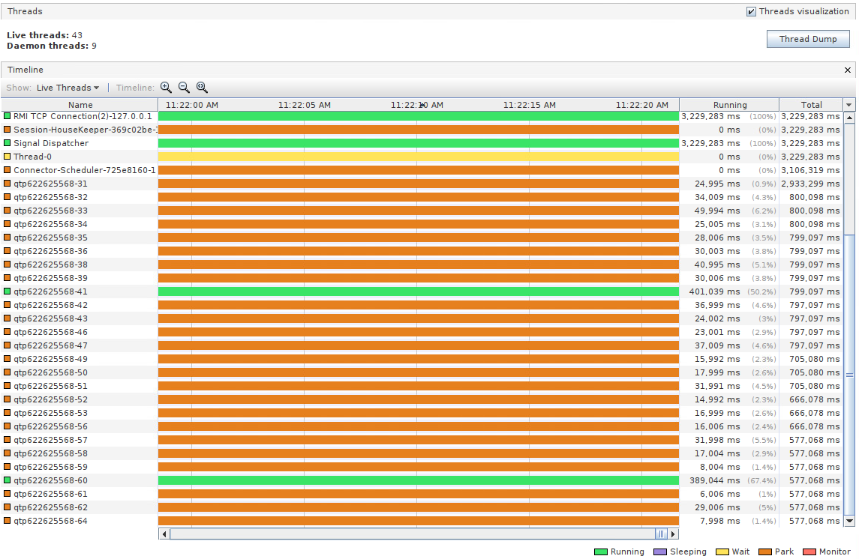
hotstone.littleworld.dk
HotStone game server – with no games running
  Worker
  threads are
  “parked”
  HTTP broker
  uses
  Spark-Java
  uses Jetty
    Which may
    run up to
    200
    threads

Slide 50
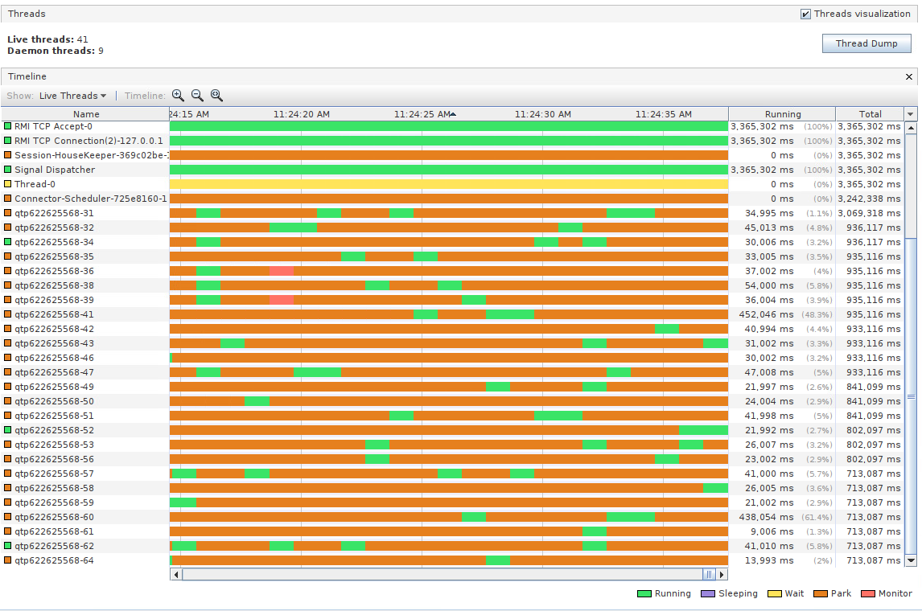
hotstone.littleworld.dk
With 300 concurrent games running
Still way from
begin
loaded

Slide 51
Conclusions
Happy Coding...

